Slide 1

DSP Based QRS Detection Using Pan-Tomkins Algorithm
Presented By:
Abdul Falah Majeed (B22ECB01)
Abhijith U (B22ECB02)
Bibin Baby (B22ECB24)
Salmanul Faris PV (B22ECB60)
Guided By:
Dr. Nissan Kunju

Slide 2
| Contents
Introduction
Objectives
Literature Review
Work Done
Results and Discussion
Conclusion
References

Slide 3
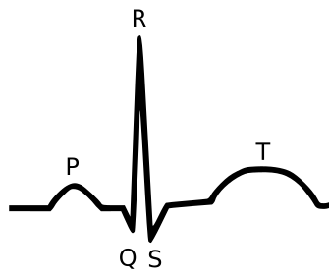
| Introduction
Electrocardiograms (ECG) are critical tools in cardiac diagnostics, where accurate detection of the QRS complex plays a key role in identifying heart rhythms and abnormalities.
QRS detection is challenging due to both physiological variability in QRS morphology and the presence of various noise sources in ECG signals.
To address this, the Pan-Tompkins algorithm uses digital filtering, nonlinear transformations, and adaptive thresholding for robust, real-time QRS detection
DSPs offer hardware-level parallelism, low latency, and energy efficiency, making them far better suited than general-purpose software for fast and reliable biomedical signal processing like QRS detection.
Fig 1

Slide 4
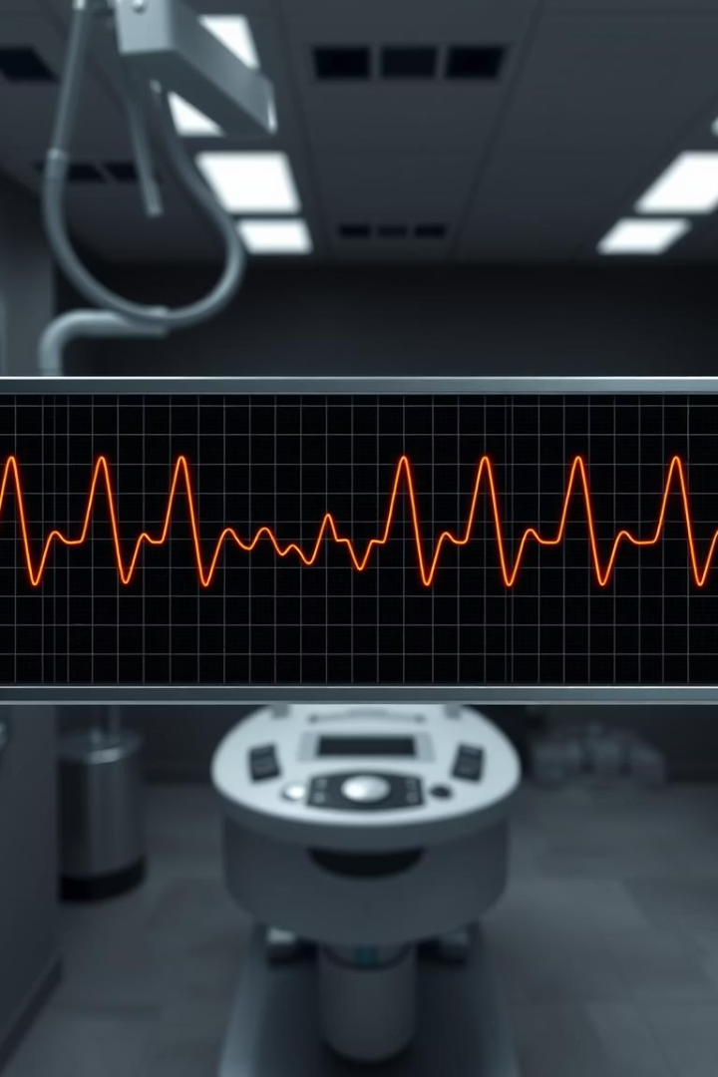
Objectives
Implement the Pan-Tompkins algorithm for ECG signal processing in MATLAB and translate it into C for improved efficiency.
Emulate the C program using Code Composer Studio for DSP simulation and deploy it on a DSP(TMS320C6748) for hardware validation.
Test the algorithm using the MIT-BIH Arrhythmia Database and custom ECG signals collected using the AD8232 sensor.
Analyze and compare the algorithm’s performance across different ECG datasets.

Slide 5
| Literature Review
SI. No. | Reference | Inference
1 | Pan, J., & Tompkins, W. J. (1985). A real-time QRS detection algorithm. IEEE Transactions on Biomedical Engineering. | Proposes the Pan–Tompkins algorithm using filtering and adaptive thresholds for accurate QRS detection.
2 | Lourenço, A., Silva, H., Leite, P., Lourenço, R., & Fred, A. (2019). Review and comparison of QRS detection algorithms for arrhythmia diagnosis. IEEE Conference Publication. | Compares Pan–Tompkins with other methods using public ECG datasets, analyzing detection accuracy and reliability.
3 | Pavlatos, C., Dimopoulos, A., Manis, G., & Papakonstantinou, G. (2005). Hardware implementation of Pan & Tompkins QRS detection algorithm. National Technical University of Athens. | Describes a HW-based implementation of the algorithm, highlighting its efficiency and suitability for embedded systems.

Slide 6

| Tools Used
Software:
MATLAB (for algorithm simulation and testing)
Code Composer Studio (for programming and debugging on TMS320C6748)
Hardware:
TMS320C6748 DSP Processor (for implementing the Pan & Tompkins algorithm)
AD8232 Module (for ECG data acquisition)

Slide 7
| Block Diagram
Low Pass Filter
High Pass Filter
Derivation
Squaring
Function
Integration
Adjusting Thresholds
Decision

Slide 8
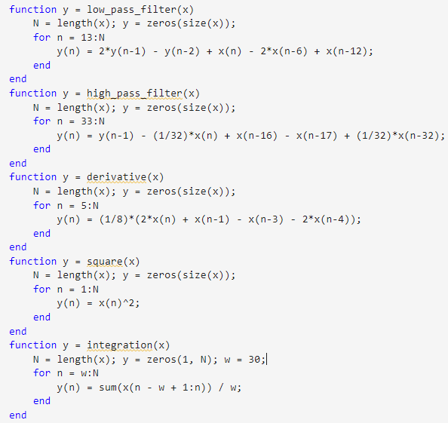
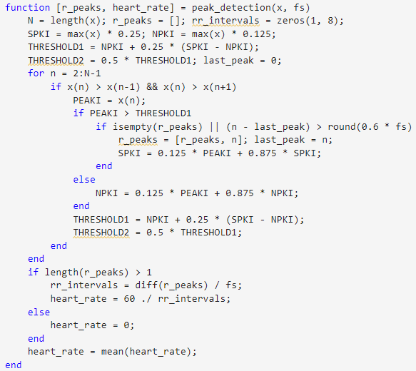
| MATLAB Implementation
Filters
Peak Detection & Heart Rate

Slide 9
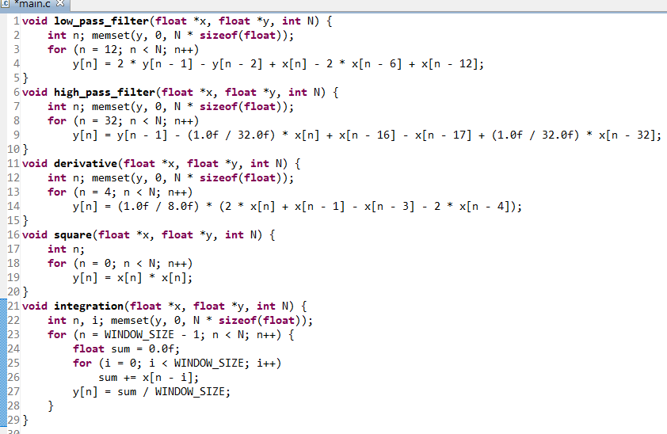
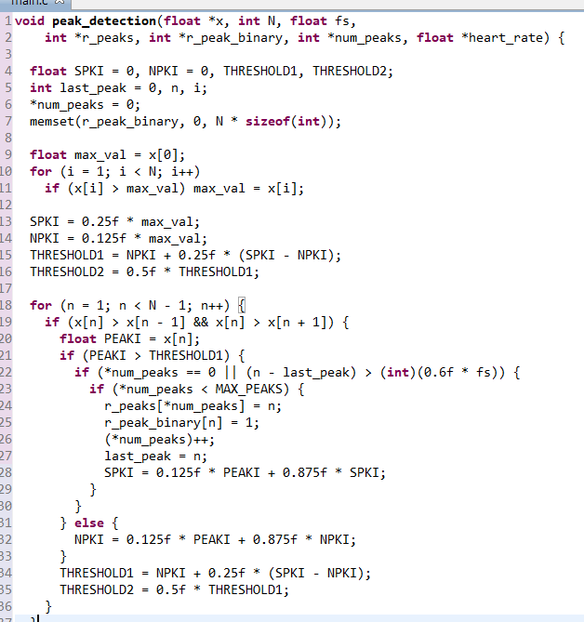
| C Code / Code Composer Studio (CCS)
Filters
Peak Detection & Heart Rate

Slide 10
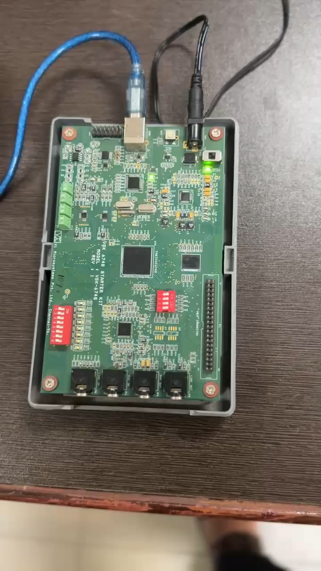
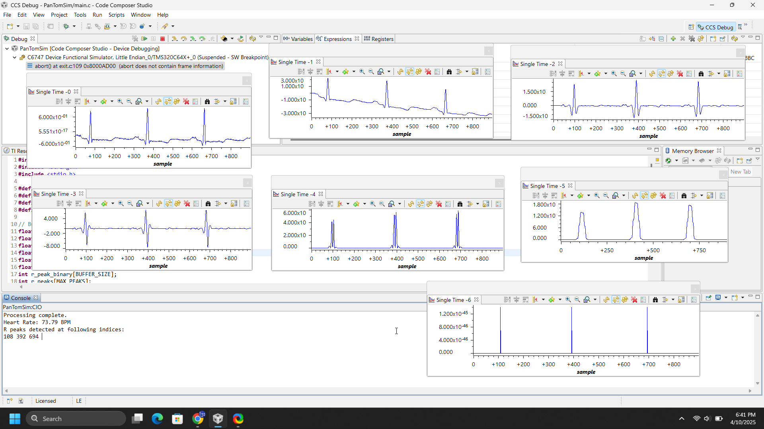
| Hardware Implementation

Slide 11
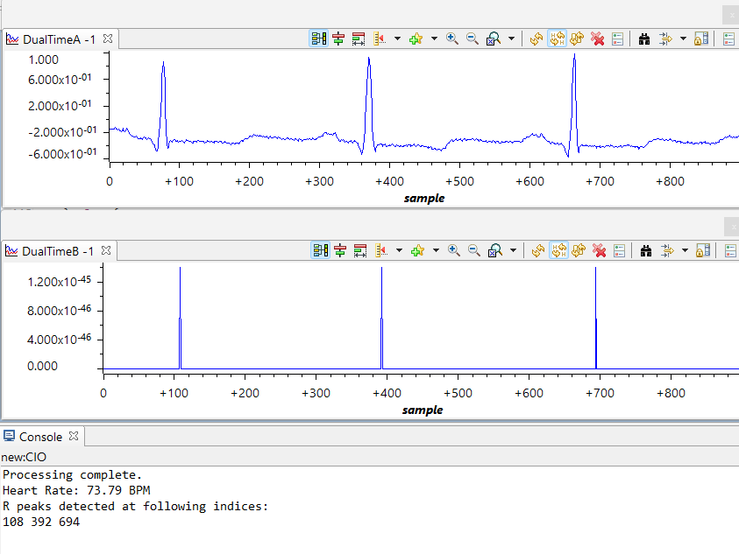
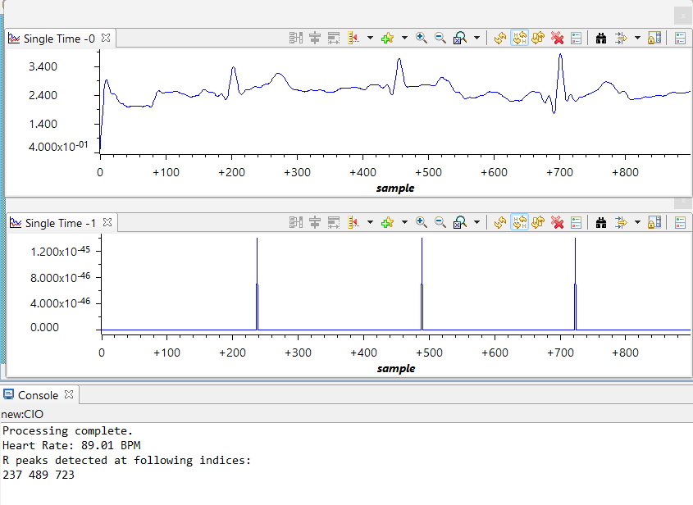
| Testing and Evaluation
Detection on MIT-BIH Arrhythmia Database | Detection on Real-World Noisy ECG (AD8232 Sensor)

Slide 12
| Conclusion
Successfully implemented the Pan-Tompkins QRS detection algorithm on the TMS320C6748 DSP platform.
Testing was performed offline using both a sample from the MIT-BIH arrhythmia database and our own noisy ECG recordings collected using the AD8232 sensor.
The implementation showed robust and accurate R-peak detection, even on low-quality, noisy signals, confirming the effectiveness of the algorithm on real-world data.
Future scope: The algorithm’s robustness in noisy environments makes it ideal for real-time, ambulatory, and wearable ECG monitoring, enhancing home care and point-of-care diagnostics.

Slide 13
| References
Pan, J., & Tompkins, W. J. (1985). A real-time QRS detection algorithm. IEEE Transactions on Biomedical Engineering.
Lourenço, A., Silva, H., Leite, P., Lourenço, R., & Fred, A. (2019). Review and comparison of QRS detection algorithms for arrhythmia diagnosis. IEEE Conference Publication.
Pavlatos, C., Dimopoulos, A., Manis, G., & Papakonstantinou, G. (2005). Hardware implementation of Pan & Tompkins QRS detection algorithm. National Technical University of Athens.

